Slide 1
Writing: How to answer a prompt
Notes:
SAT ACT logo from OU news bureau http://www.ounewsbureau.com/?p=8067
Writing image from Jeffrey James Pacres Flickr.com
FSA logo from Lake Country Public schools: http://www.lake.k12.fl.us/cms/lib05/FL01000799/Centricity/Domain/8716/FSA.JPG

Slide 2
Overview
Step 1: Analyze the prompt
Step 2: Flip the question
Step 3: Answer
Step 4: Topic Sentences
Step 5: Outline
Conclusion
home

Slide 3
Step 1: Analyze the prompt
Write an essay in which you explain how conflicts in Spiderman shape the hero’s decisions.
Read the prompt.
Underline the “essay” word.
Circle the question word.
Highlight the topic word.
Highlight the central idea.

Slide 4
Step 2: Flip the question
Write an essay in which you explain how conflicts in Spiderman shape the hero’s decisions
Look at the question word.
Flip the question to a sentence.
Leave 2-3 blanks.
The blanks will be main ideas later.
The conflicts in Spiderman shaped Peter Parker’s decisions by __________and ____________.
Notes:
Photo from flickr.com user Toby Bradbury. I cropped this image in Photoshop, added the text overlay, changed the brightness and saturation of the photo so that it would tie in with my text boxes somewhat. I used the masking properties on one layer to reveal the original pancake color in order to make it stand out. I used a border on it from Powerpoint to round the edges so that it would match the other boxes.

Slide 5
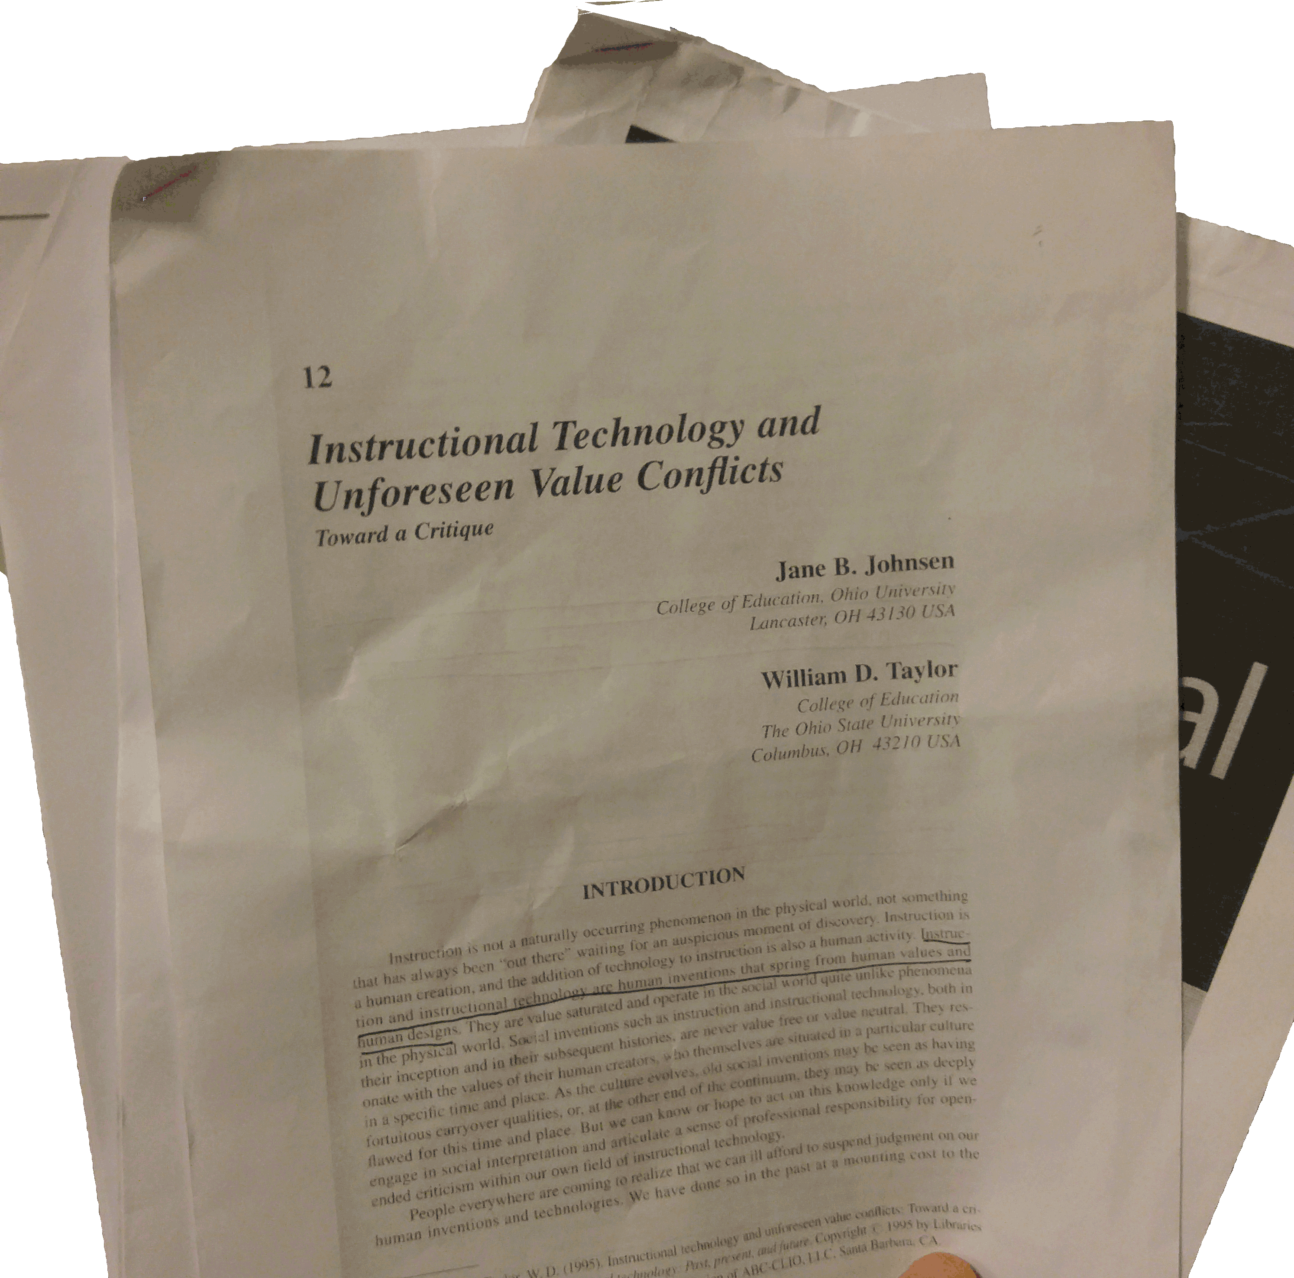
Step 3: Answer
Research your answers.
Look in provided articles.
Use your own ideas (sometimes).
Fill in the blanks
This sentence is your thesis!
Last sentence of first paragraph.
All other paragraphs explain it.
The FSA test has 2-3 articles or graphs for a prompt
The conflicts in Spiderman shaped Peter Parker’s decisions by making him take responsibly and causing him to take action against villains.
Notes:
I took this picture myself and edited it in Photoshop using layers to create a transparent layer..

Slide 6
Step 4: Topic Sentences
Introduction: 1st paragraph
The conflicts in Spiderman shaped Peter Parker’s decisions by making him take responsibly and causing him to take action against villains.
Look at the ideas in the blanks.
They are main ideas for other paragraphs.
Each one = topic sentence.
Each one = first sentence of body paragraph.
Body: 2nd paragraph
Conflicts early in the story make Peter take responsibly for everything that happens...
Body: 3rd paragraph
Conflicts caused by the villains and Peter’s sense of responsibility cause Peter to take action against the villians.

Slide 7
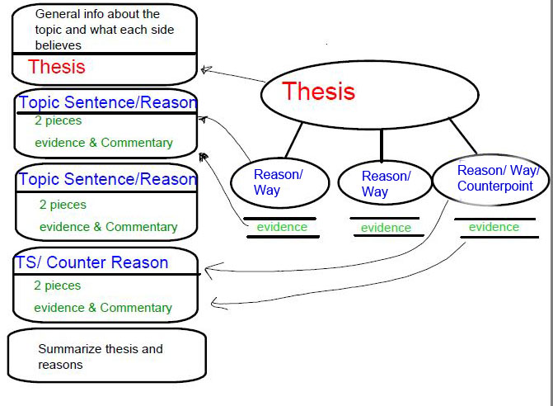
Step 5: Outline
Take the thesis and topic sentences.
Use a bubble outline.
Helps with ideas.
Organizes writing.
No underdeveloped ideas.
No rambling.
The relationship between the outline and the essay. Download it as a pdf.
Notes:
I created this diagram in the SmartNotebook software at my school (Smartboard), exported it as a pdf, using Snipping tool to turn it into a JPEG, cropped it, and edited some of the text in Photoshop.

Slide 8
Conclusion
Click here to learn about the FSA.
Visit this site for more examples of prompts.
Download the bubble outline.
Email me your with questions.
Notes:
This image is from Pixabay.com user Upsplash. I cropped it, changed the “curve” on it in Photoshop so the sky would darken a bit, and added the text overlay.

