Slide 1
COMMENTING ON
PEER WRITING
PRESENTED BY: NICOLE CHAPMAN
Notes:
Slide 1 image notes:
I found this image on morguefile.com (royalty free, no attribution required). In Keynote, I lowered the saturation and increased the exposure to make the image fit with the color scheme of other pictures in the presentation.

Slide 2
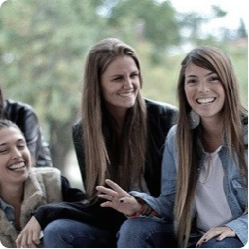
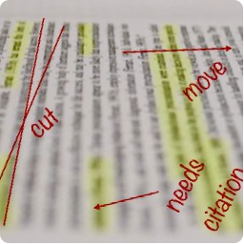
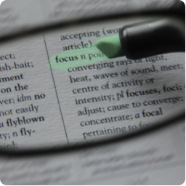
TABLE OF CONTENTS
1
2
3
BUILD
RAPPORT
IDENTIFY TYPES OF ERROR
LOOK FOR
PATTERNS
Notes:
Slide 2:
I found Image 1 and Image 3 on compfight.com. I adjusted the saturation and tint on both in Keynote. I found image 2 on morguefile.com (royalty free, no attribution required). I used Photoshop to add text overlay meant to look like red pen marks on an essay.
Image 1 used under Creative Commons from https://www.flickr.com/photos/54689415@N00/5712512722/
Image 3 used under Creative Commons from www.flickr.com/photos/42408834@N06/4546017269/

Slide 3
1
BUILD RAPPORT
Notes:
Slide 3:
I found this image on compfight.com, cropped it in iPhoto, and adjusted the saturation in Keynote.
Image used under Creative Commons from https://www.flickr.com/photos/codnewsroom/9661919079/

Slide 4
WAYS TO BUILD RAPPORT
BODY LANGUAGE
QUESTIONS
POSITIVE FEEDBACK
Notes:
Slide 4:
I created the word cloud image. I found an icon from flaticon.com and used tagul.com to create a word cloud with a transparent background.
Icon used/modified under Creative Commons from http://www.flaticon.com/free-icon/students-talking-on-a-table-with-a-computer_43853

Slide 5
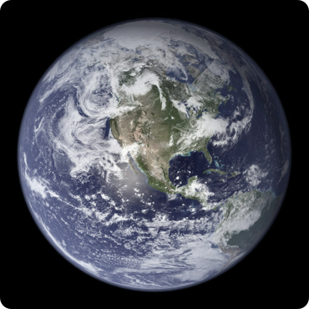
2
IDENTIFY TYPES OF ERROR
GLOBAL
LOCAL
Notes:
Slide 5:
I found both images on compfight.com, but made no alterations to the images.
Image 1 used under Creative Commons from http://www.flickr.com/photos/24662369@N07/4386822005/
Image 2 used under Creative Commons from http://www.flickr.com/photos/24662369@N07/4386822005/

Slide 6
GLOBAL ERRORS INCLUDE
ASSIGNMENT CRITERIA
ORGANIZATION/STRUCTURE
CONTENT
Notes:
Slide 6:
I created the word cloud image. I found an icon from flaticon.com and used tagul.com to create a word cloud with a transparent background.
Icon used/modified under Creative Commons from http://www.flaticon.com/free-icon/earth-globe-with-maps_46093

Slide 7
LOCAL ERRORS INCLUDE
WORD CHOICE
GRAMMAR
SPELLING
Notes:
Slide 7:
I created the word cloud image. I found an icon from flaticon.com and used tagul.com to create a word cloud with a transparent background.
Icon used/modified under Creative Commons from http://www.flaticon.com/free-icon/map-location_32364

Slide 8
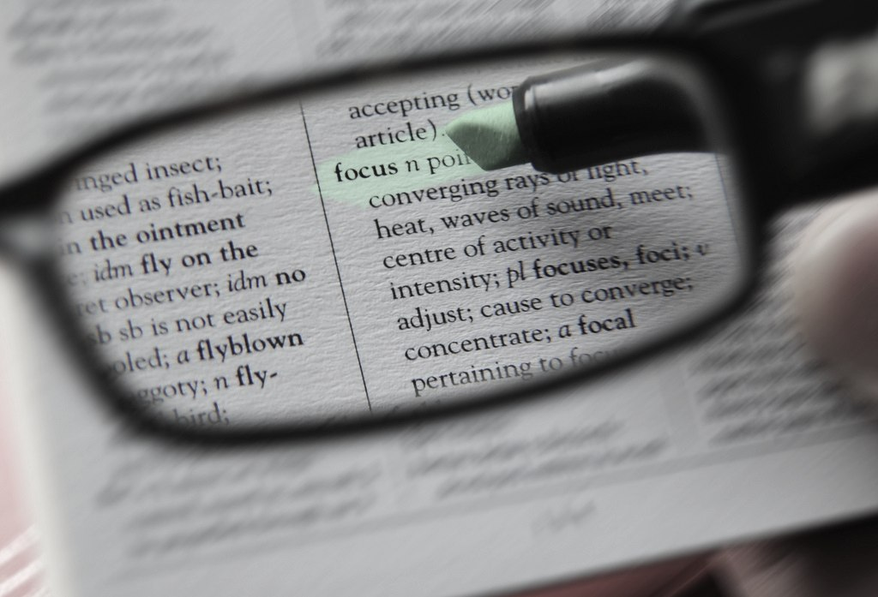
3
LOOK FOR PATTERNS
Notes:
Slide 8:
I found this image on Compfight.com and adjusted the saturation and tint in Keynote.
Image used under Creative Commons from www.flickr.com/photos/42408834@N06/4546017269/

Slide 9
SPOT THE PATTERN
LOOK FOR HIERARCHY
LIMIT SUGGESTIONS
OFFER RESOURCES
Notes:
Slide 9:
I created the word cloud image. I found an icon from flaticon.com and used tagul.com to create a word cloud with a transparent background.
Icon used/modified under Creative Commons from http://www.flaticon.com/free-icon/college-research_78537

Slide 10
AVOID PROOFREADING
ENGAGE
EMPOWER
OFFER TIPS
Notes:
Slide 10:
I created the word cloud image. I found an icon from flaticon.com and used tagul.com to create a word cloud with a transparent background.
Icon used/modified under Creative Commons from http://www.flaticon.com/free-icon/x-button_69324

Slide 11
THANK YOU
ADDITIONAL TUTORING RESOURCES
PRACTICE EXERCISE
WATCH AGAIN
PART 1
PART 2
PART 3
EMAIL

