Slide 1


How to Create a Tessellation
A step by step guide
Diana Amend

Slide 2
Table of Contents
What is a Tessellation
Materials Needed for Tessellation
Step 1 – Create a Square
Step 2 – Making the First Cut
Step 3 – Align and Tape
Step 4 – The Final Cut
Step 5 – Tape and Trace
Student Samples

Slide 3
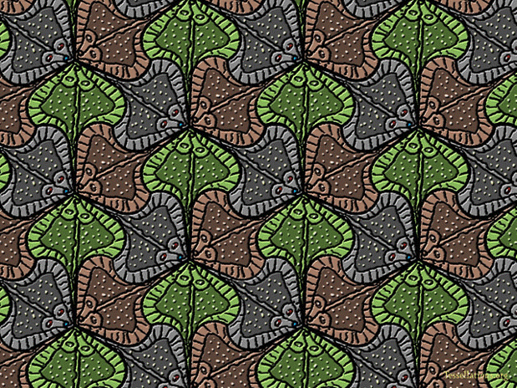
What is a Tessellation
Repeated shape
No gaps
No overlaps

Slide 4

M.C. Escher
The Mathematical Art of M.C. Escher

Slide 5
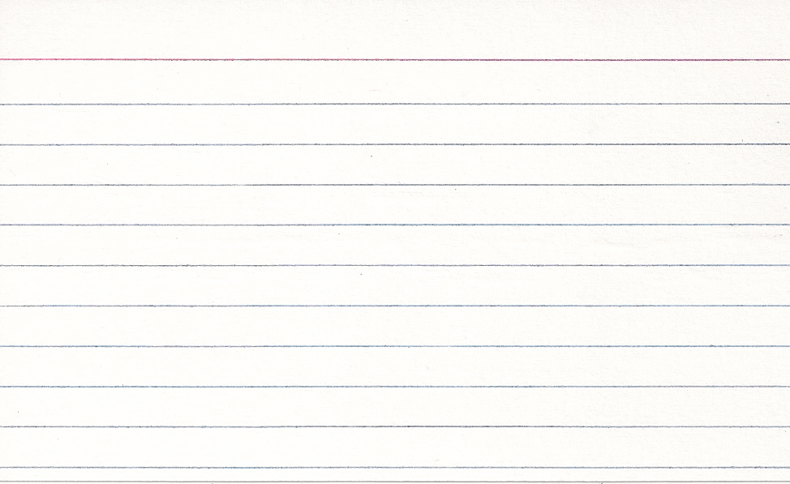
Materials Needed for Tessellation
Lined index card
Ruler
Scissors
Tape
Pencil
Plain Paper
3 x 5 ruled index card
Notes:
The index card was scanned.

Slide 6
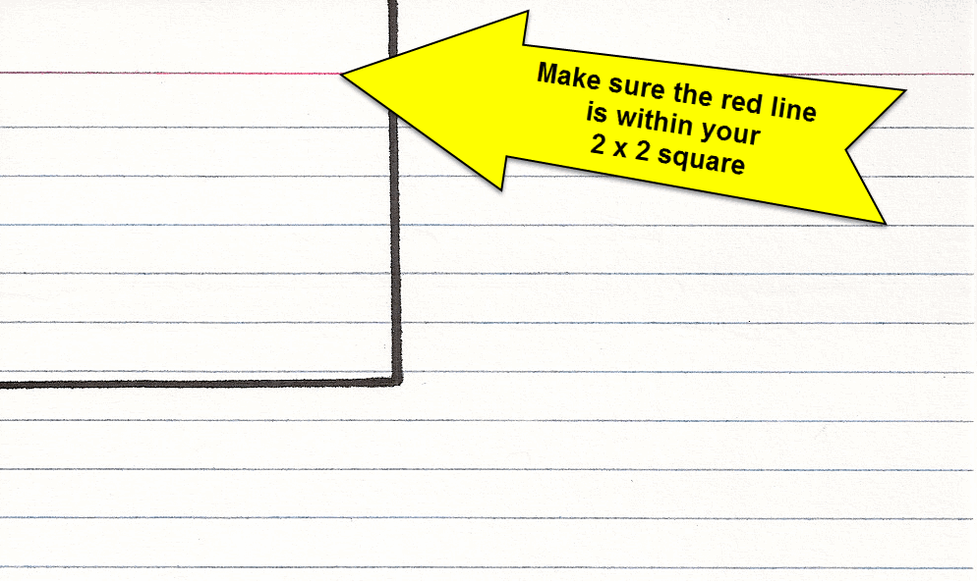
Create a Square
Draw a 2 x 2 inch square
Include the horizontal red line with the square
Notes:
The index card was scanned. The arrow and text were added using SnagIt.

Slide 7
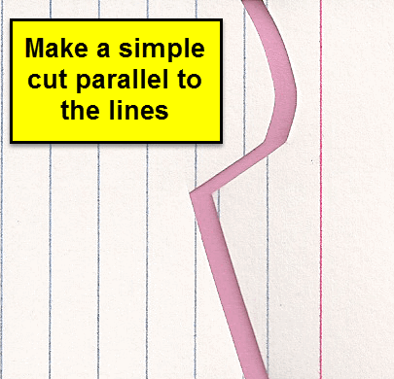
Making the First Cut
Parallel to blue lines
Simple design
Not too detailed
Notes:
The index card was scanned. The text and text box was added using SnagIt. There is a piece of colored paper in the background of the index card to show contrast between the two pieces.

Slide 8
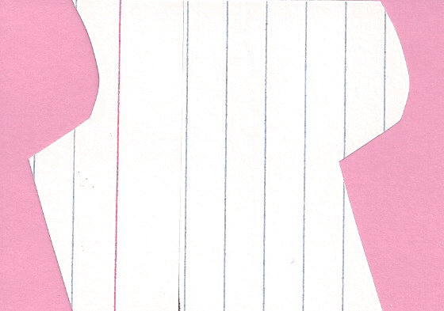
Align and Tape
Slide one piece over the other
Make sure edges are flush
Tape carefully
Notes:
The index card was scanned. There is a piece of colored paper in the background of the index card to show contrast of the cut edges.

Slide 9
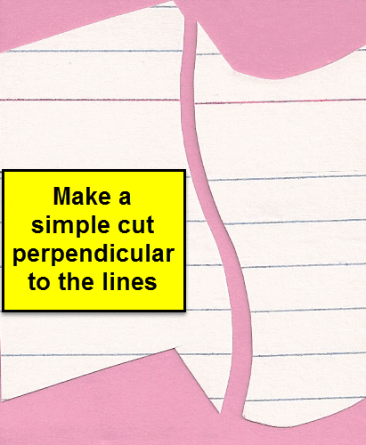
The Final Cut
Cut perpendicular to the lines
Simple design
Notes:
The index card was scanned. The text and text box was added using SnagIt. There is a piece of colored paper in the background of the index card to show contrast between the two pieces.

Slide 10
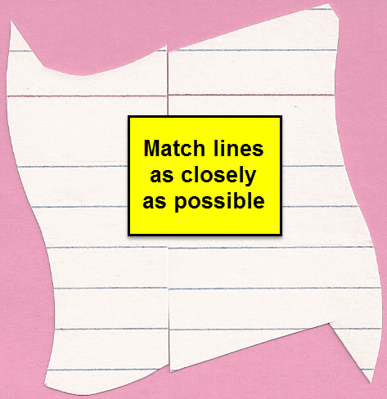
Tape and Trace
Slide one piece over the other
Match up the lines
Seams should intersect when taped
Trace your piece
Notes:
The index card was scanned. The text and text box were added using SnagIt. There is a piece of colored paper in the background of the index card to show contrast of the cut edges.

Slide 11
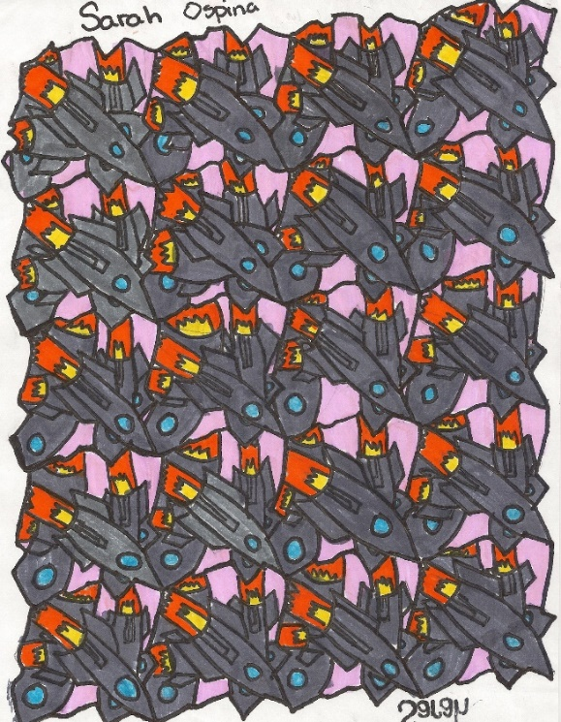
What do you see?
After you trace look for an image
Try turning the paper
Color your tessellation
Click on the picture to enjoy a brief video of student created tessellations.
Notes:
The graphic is a student created tessellation. It also serves as a link to the video.

Slide 12
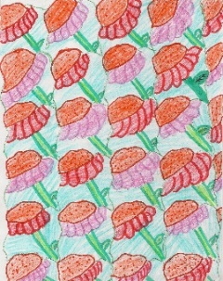
Thank you for watching
For more information please email me at
Diana_Amend@knights.ucf.edu
End Show
Watch again
Notes:
The graphic is a student created tessellation. It also serves as a link to the beginning of the presentation.

