Slide 1

A Brief history of Cigars
Allison Clancy

Slide 2

Home page/content
The US Trade Embargo on Cuba
The Origin of the Cigar
Why Cuba?
Cigar City: Tampa
Pop-Culture
Last, but Important
Next Slide

Slide 3
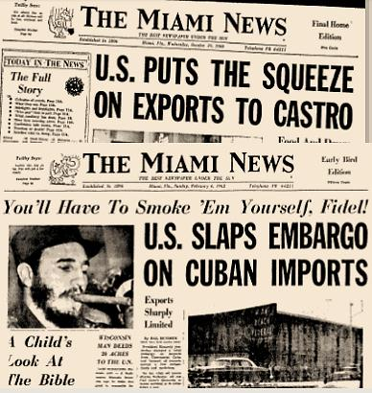
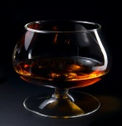
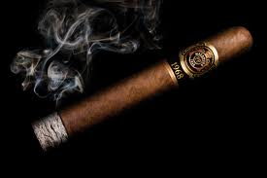
U.S. Trade Embargo
The Cuban Revolution
Implications of Communism
President Kennedy
Recent
http://www.forbes.com/sites/realspin/2013/01/16/its-time-for-the-u-s-to-end-its-senseless-embargo-of-cuba/
Old paper clippings correlating the importance of the cigar to Cuba and the trade embargo.
http://mambiwatch.blogspot.com/2012/02/what-embargo-part-1.html
Back
Home Page
Next Slide
Notes:
I changed the picture style, changed the picture color and sharpened it

Slide 4
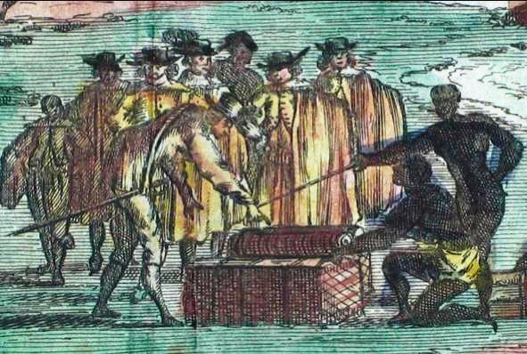
A Cigar’s origin
Unknown
Mayans
Christopher Columbus
Interesting fact
Christopher Columbus receiving cigar tobacco as a gift from the natives
http://www.nationalcigarmuseum.com/cigar_history/history_1460-1760.html
Back
Home Page
Next Slide
Notes:
Under corrections I lightened the image and picture brightness

Slide 5
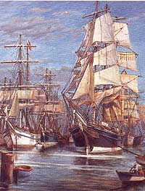

Why Cuba?
Geographical location
Distribution
The ships used to distribute Cuban cigars all over the world
http://www.cubaheritage.org/articles.asp?lID=1&artID=123
Back
Home Page
Next Slide

Slide 6
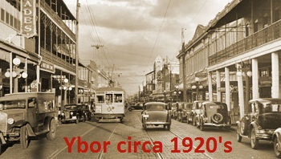
Cigar City: Tampa
The Cigar Capital
Ybor
Economic impacts
The Great Depression
Development of cigar society
Back
Home Page
Next Slide
Notes:
Here I did text overlay.

Slide 7
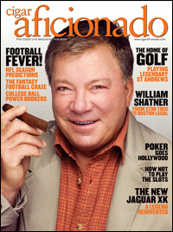
Pop-culture
Classy and luxurious!
Celebrities
Cigar Aficionado
http://www.cigaraficionado.com/
Back
Home Page
Next Slide

Slide 8
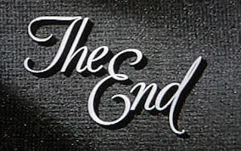
Last, but important
A Brief Wrap up
For more information on this power point presentation please email Allison Clancy allison.clancy@knights.ucf.edu
End Show
Back
Home Page
Notes:
I changed the transparency of the original image and the color, it was originally black.

