Slide 1
Storyboarding for Instructional Design
Notes:
Script: Storyboards are a quick and efficient way for an Instructional Designer to present a clear idea of how they intend to present course content.

Slide 2
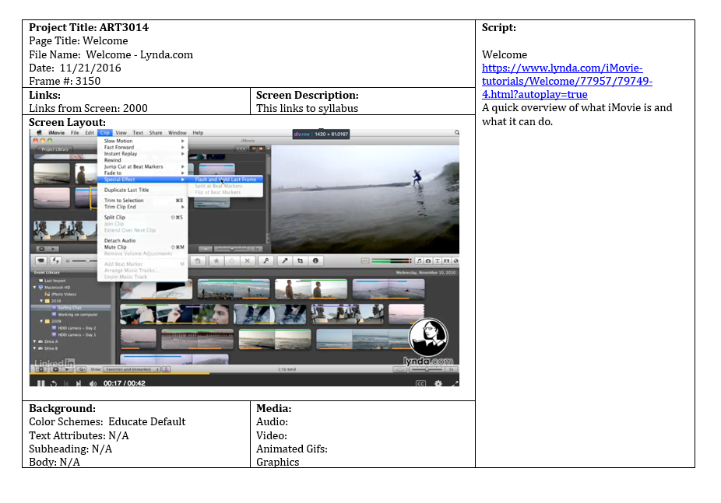
Notes:
Video Note: Image pans up as voiceover plays
Script: A storyboard includes descriptions or samples of audio, visual media, and text elements that the Instructional Designer intends to include in their online learning. This provides not just a preview of the content that will be presented, but also a preliminary idea of the structure and flow of the course.

Slide 3
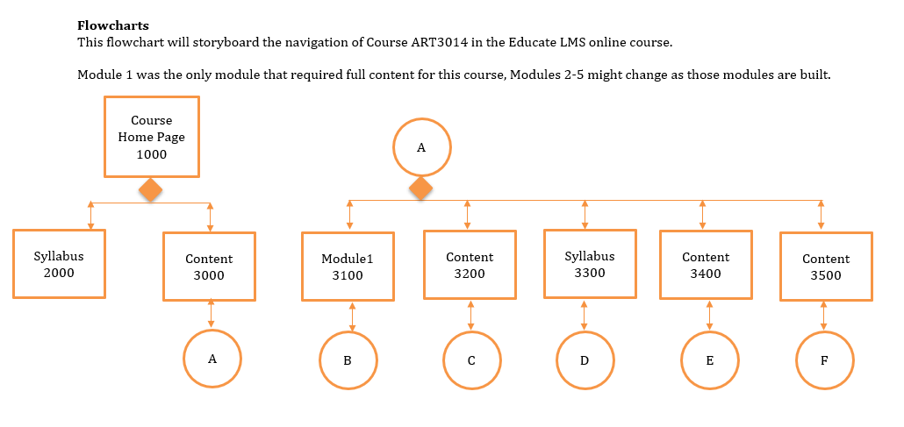
Notes:
Video Note: Image pans from left to right as voiceover plays
Script: Building a storyboard is also an opportunity to organize content according to when it will be encountered by learners. Including a flowchart allows the Instructional Designer to give a visual depiction of the progression of content, pages, or slides in a course

Slide 4
Notes:
Script: In addition to a flowchart, an overview of course objectives and an overarching outline of course content helps to showcase both the purpose and scope of the course

Slide 5
Storyboard Contents
Notes:
Background Image Notes: office-594132_960_720.jpg obtained from pixabay. Free for commercial use. No attribution required.
Script: Each page or slide of planned e-learning content should be represented in the storyboard. Most storyboards contain the following information:

Slide 6
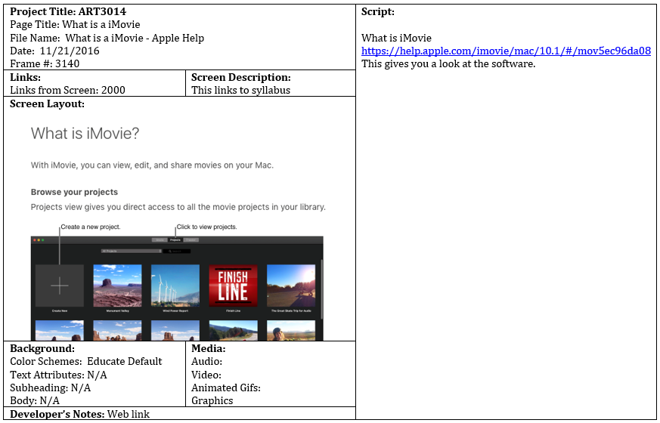
Storyboard Contents
Project Title and Page Title
Notes:
Script: The project title and individual page title

Slide 7
Storyboard Contents
Project Title and Page Title
Text
Notes:
Script: Text that will be presented on a page or display

Slide 8
Storyboard Contents
Project Title and Page Title
Text
Graphics
Notes:
Script: Graphics, such as images that will be utilized, any background image, and the overall layout of the content

Slide 9
Storyboard Contents
Project Title and Page Title
Text
Graphics
Video description
Notes:
Script: Video media, as a description or a link to the source of the video

Slide 10
Storyboard Contents
Project Title and Page Title
Text
Graphics
Video description
Audio
Notes:
Script: Audio transcript, such as voice-over narration

Slide 11
Storyboard Contents
Project Title and Page Title
Text
Graphics
Video description
Audio
Navigation
Notes:
Script: Navigation information such as links that will be included in the page being described and where they will take the learner

Slide 12
Storyboards Are Collaborative
Notes:
Image Notes: analyzing_people_brainstorming.jpg obtained from pixabay. Free for commercial use. No attribution required.
Script: Once complete an Instructional Designer may present their storyboard to team members or shareholders involved in the instruction, requesting feedback to ensure that all necessary content is included and being conveyed appropriately and efficiently. Having the course mapped out and getting a consensus prior to developing the course further can save the Instructional Designer time from having to redo a project from scratch because their hard work didn’t meet the expectations of their clients.

Slide 13
Resources
Brigham, D. (2014, April 30). Instructional Design Essentials: Storyboarding [Lynda.com online course]. retrieved from https://www.lynda.com/PowerPoint-tutorials/Welcome/160064/171576-4.html?org=ucf.edu
Malamed, C. (2019, January 17). Storyboards for eLearning. Retrieved June 2, 2019, from http://theelearningcoach.com/elearning_design/storyboards-for-elearning/
Notes:
Script: Storyboards are a quick and efficient way for an Instructional Designer to present a clear idea of how they intend to present course content.

