Slide 1

Caravaggio
A LESSON IN SIGNIFICANCE

Slide 2
LESSON OBJECTIVES
Understand the basic biographical information of Caravaggio’s life
Understand how Caravaggio’s early life impacted later work
Identify paintings from different times in Caravaggio’s life
Understand the impact of chiaroscuro in art history

Slide 3
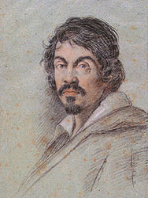
Basics
Born in Italy in Autumn 1571
Died Summer 1610 in Tuscany
Famous for use of extreme chiaroscuro
Trouble in later life
Mysterious circumstances of death
Leoni, O. (1621). Portrait of Michelangelo Merisi da Caravaggio. Florence: Biblioteca Marucelliana.

Slide 4
Early life (1571 – 1592)
Born Michelangelo Merisi in Lombardy, Italy
Apprentice to Simone Peterzano in 1584
Remained active in Milan until 1588
Moved to Caravaggio in 1589
No known autographed work
Exposed to three manners of painting:
  Lombard
  Leonardesque
  Venetian

Slide 5
Rome (1592 – 1606)
Produced cheap portraits to sell in general markets
Later collaborated with Guiseppe Cesari
  Leading mannerist painter
Explored naturalistic attention to detail

Slide 6
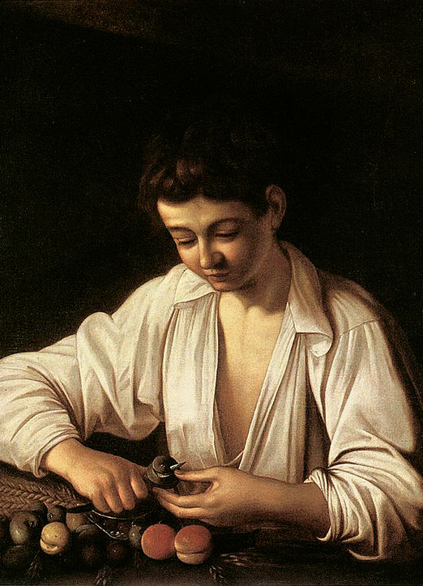
A Boy Peeling Fruit (1593)
Striking realism
Multiple meanings (allusions)
Caravaggio, M. (1593). A Boy Peeling Fruit. Florence: Fondazione Roberto Longhi.

Slide 7
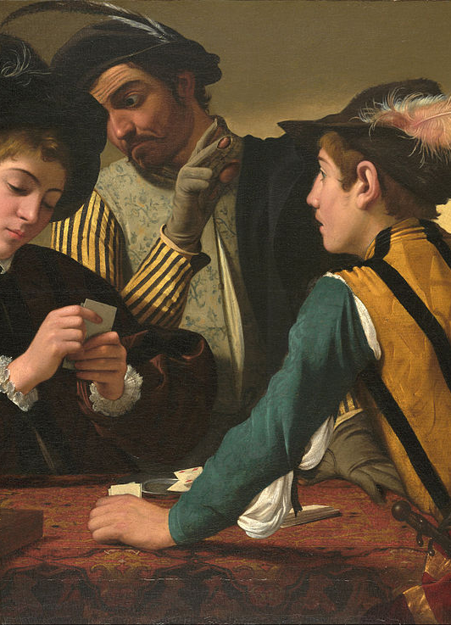
The Cardsharps (1594)
More mature painting style
Light across upper right quadrant
  Early example of dramatic lighting
Caravaggio, M. (1594). The Cardsharps (detail). Fort Worth: Kimbell Art Museum.

Slide 8
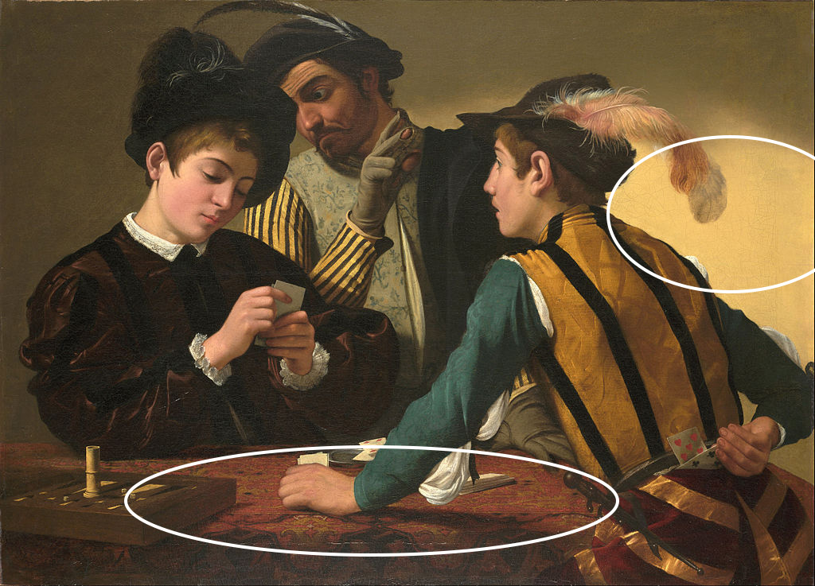
The Cardsharps (1594)
Caravaggio, M. (1594). The Cardsharps. Fort Worth: Kimbell Art Museum.
Notes:
NOTE: image was edited in Photoshop to illustrate examples of Caravaggio’s use of lighting.

Slide 9
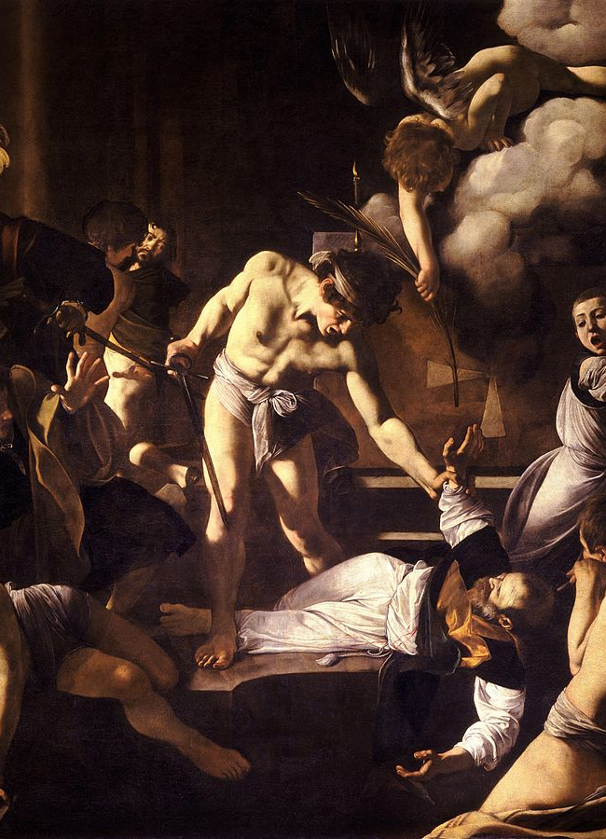
The Martyrdom of Saint Matthew (1600)
Vincenzo Guistiniani
Mature painting style
Dramatic use of lighting (chiaroscuro)
Caravaggio, M. (1600). The Martyrdom of Saint Matthew. Rome: Chiesa di San Luigi dei Francesi.

Slide 10
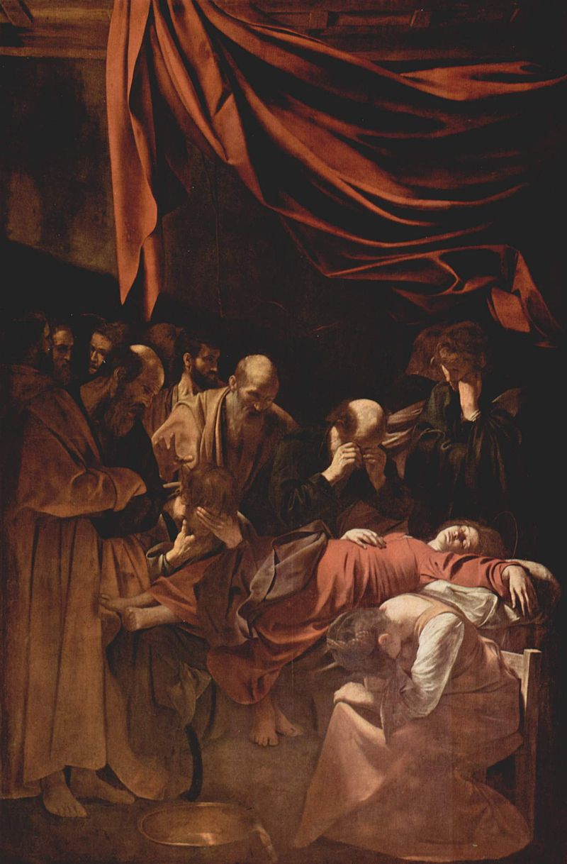
The Death of the Virgin (1606)
Return to moderate lighting
Idealization of forms
  Size of figures
  Juxtaposition
Caravaggio, M. (1606). The Death of the Virgin. Paris: Louvre Museum.

Slide 11
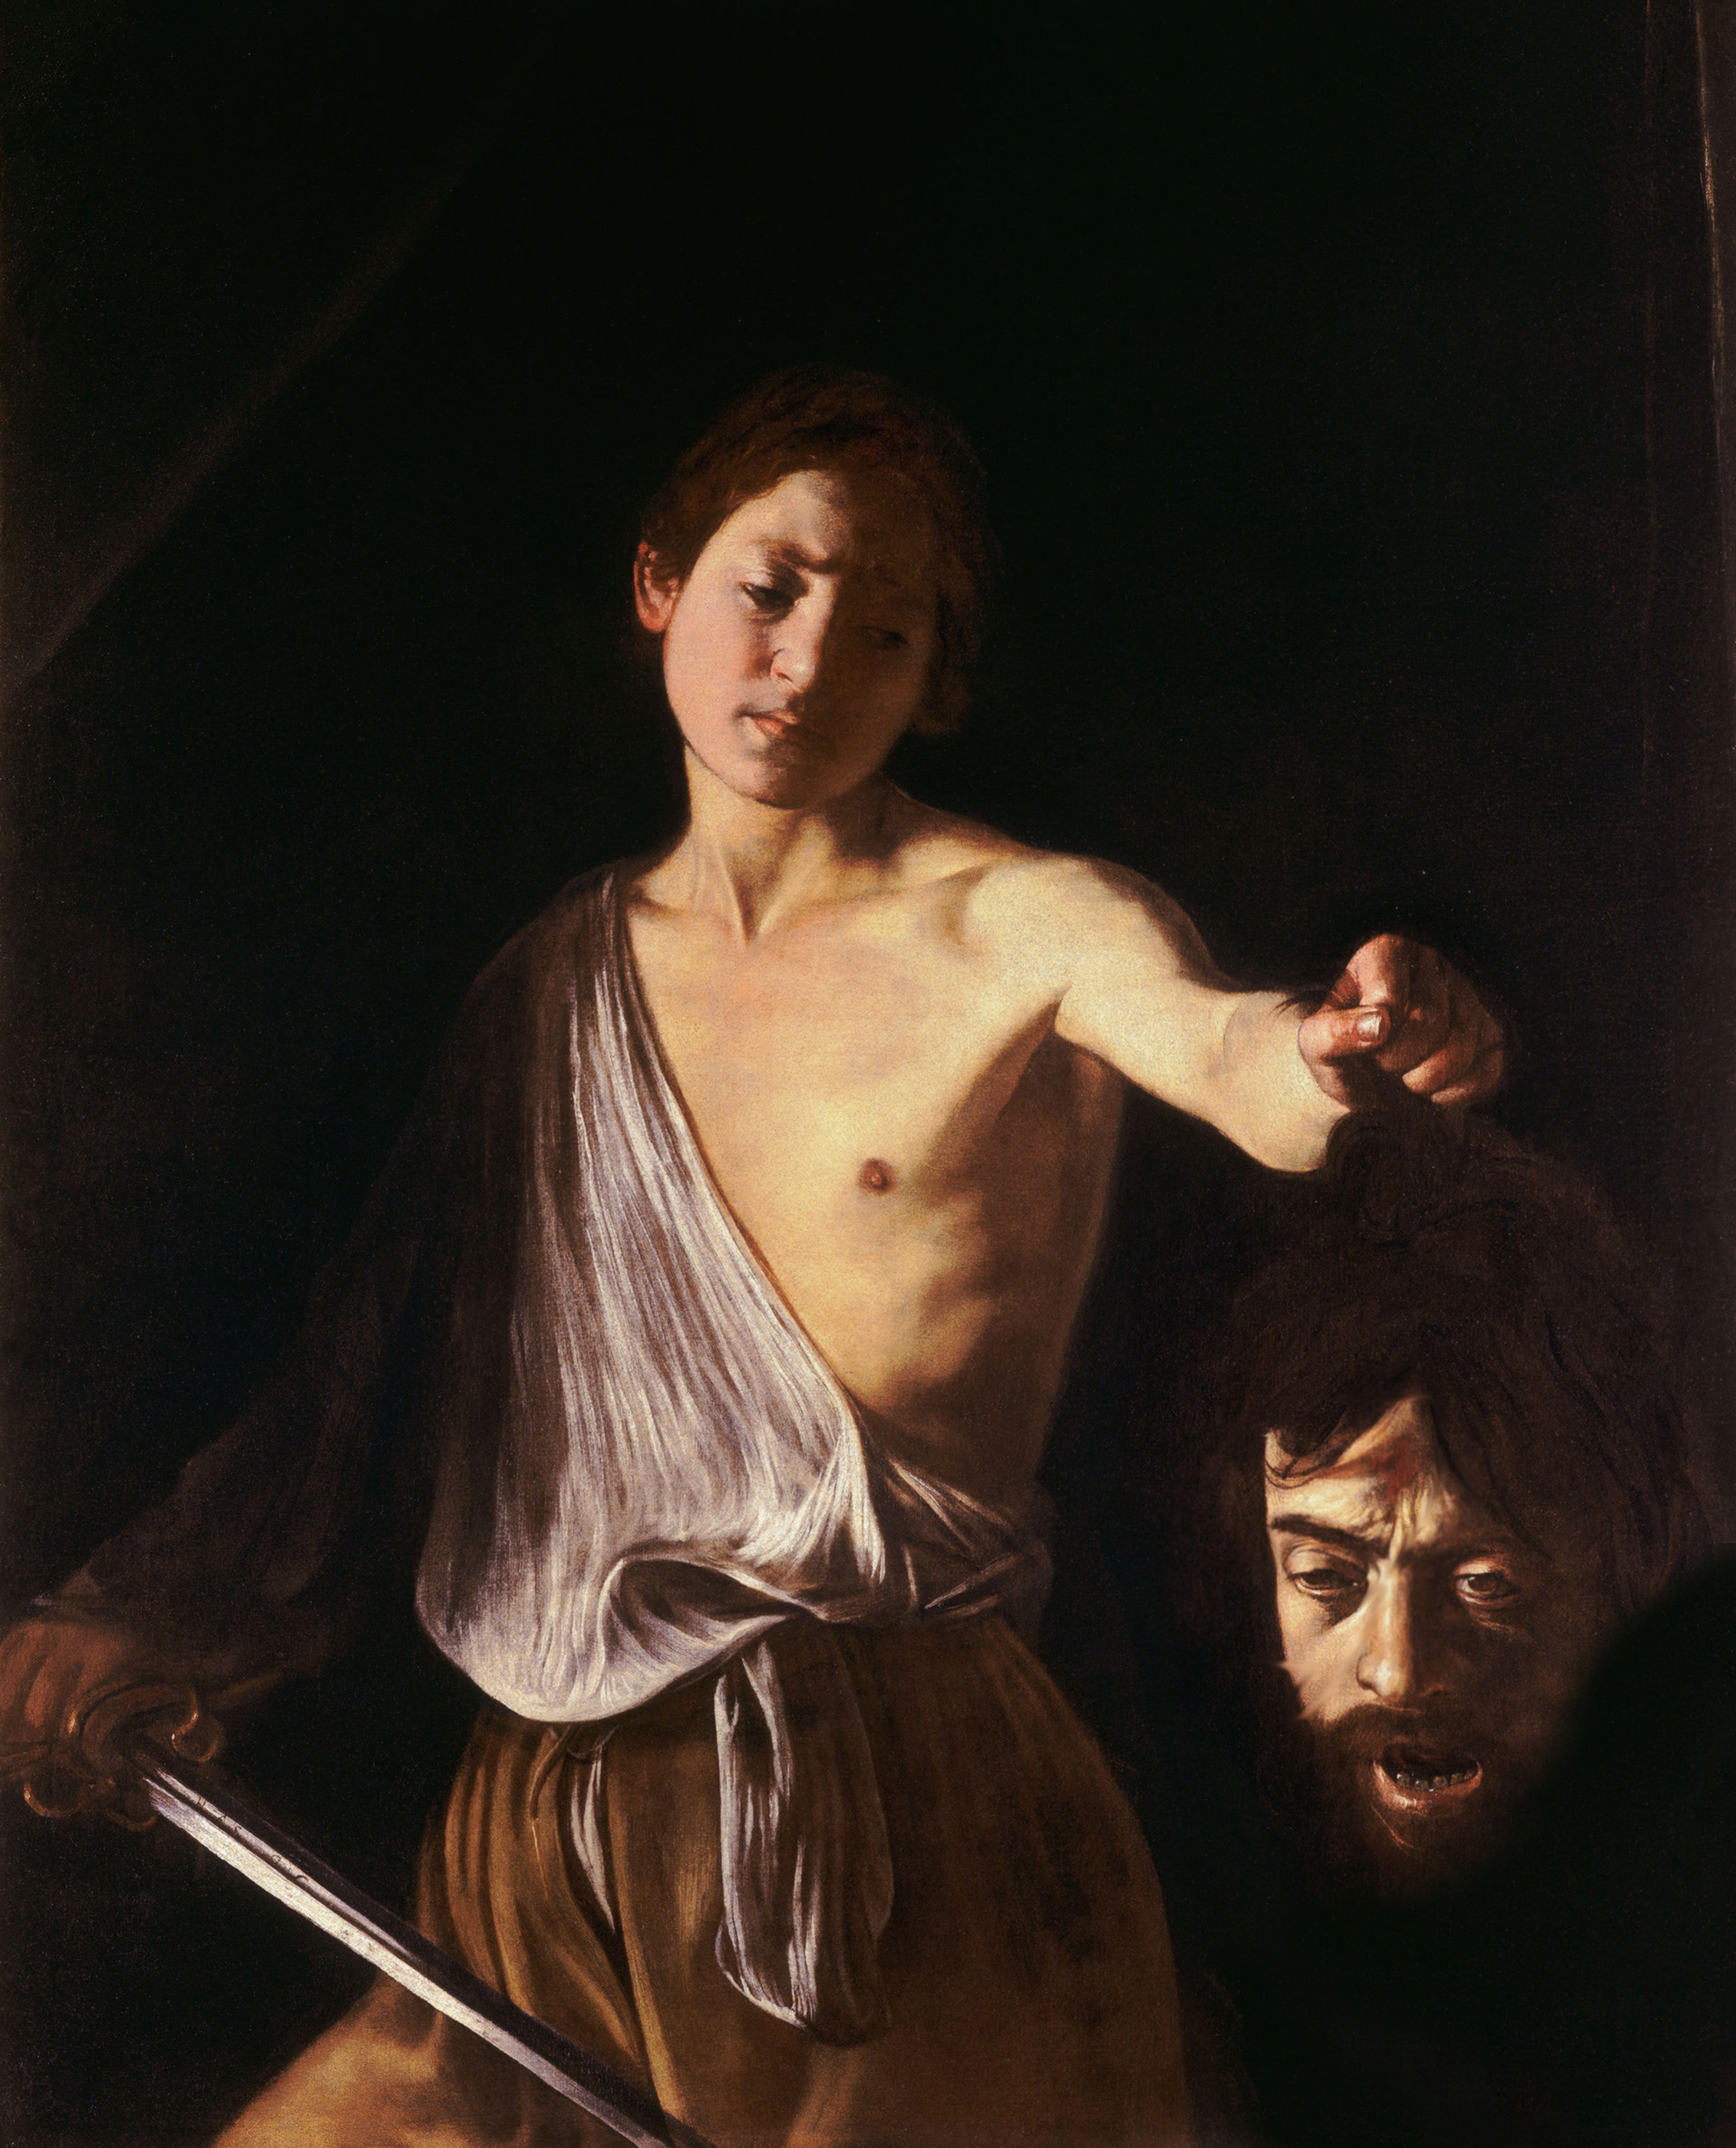
Caravaggio in trouble (1606 – 1610)
Charged with murder
Fled from Rome in May 1606
Traveled to Naples, stayed until 1607
Continued to receive notable commissions
Involved in various violent disputes
Promised a pardon by the Pope in 1610
Died en route to pardon
  Sudden fever
  Suspicious circumstances
Caravaggio, M. (1607). David with the Head of Goliath. Rome: Galleria Borghese.
Notes:
NOTE: this image was edited in Photoshop to remove some of the gore viewers may not wish to see.

Slide 12
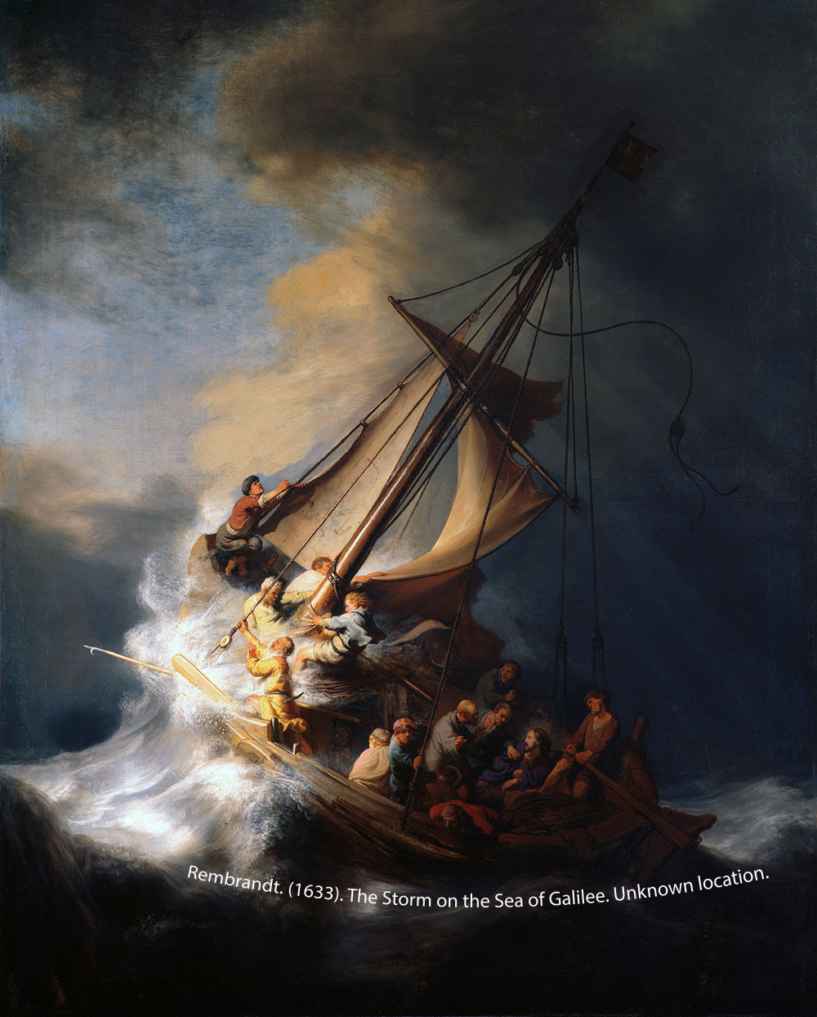
Impact on art history
Followers:
  Rembrandt, Netherlands (1606 - 1669)
  Jusepe de Ribera, Spain (1588 - 1652)
  Georges de La Tour, France (1593 – 1652)
Roberto Longhi
  One of the first to publish analysis

Slide 13
More readings
Caravaggio (Michelangelo Merisi) (1571–1610) and his Followers (The Metropolitan Museum of Art)
An Italian Antihero’s Time to Shine (The New York Times)
Chiaroscuro in Painting: The Power of Light and Dark (Empty Easel)

Slide 14
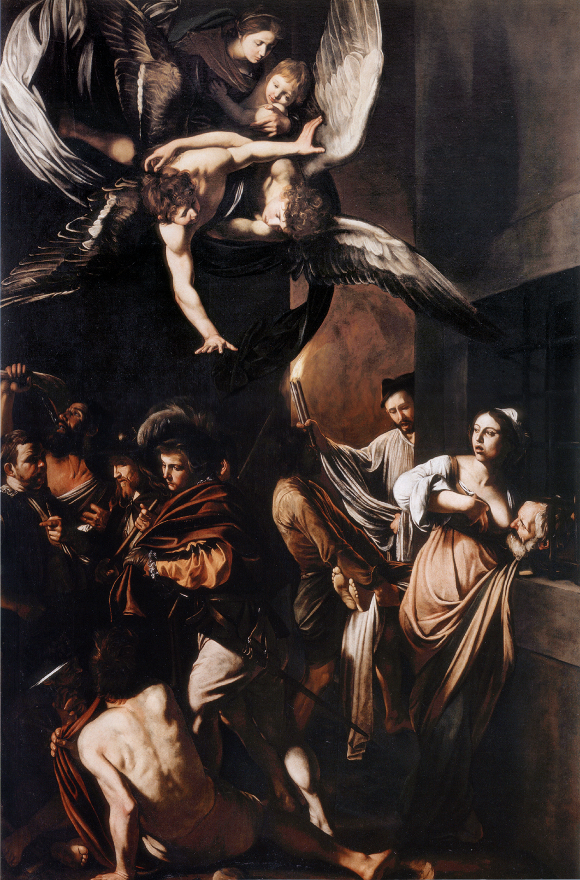
END
Source:
Caravaggio. (2016). Salem Press Biographical Encyclopedia. Retrieved from http://www.salempress.com.
Caravaggio, M. (1607). The Seven Works of Mercy. Naples: Pio Monte della Misericordia.

Slide 15
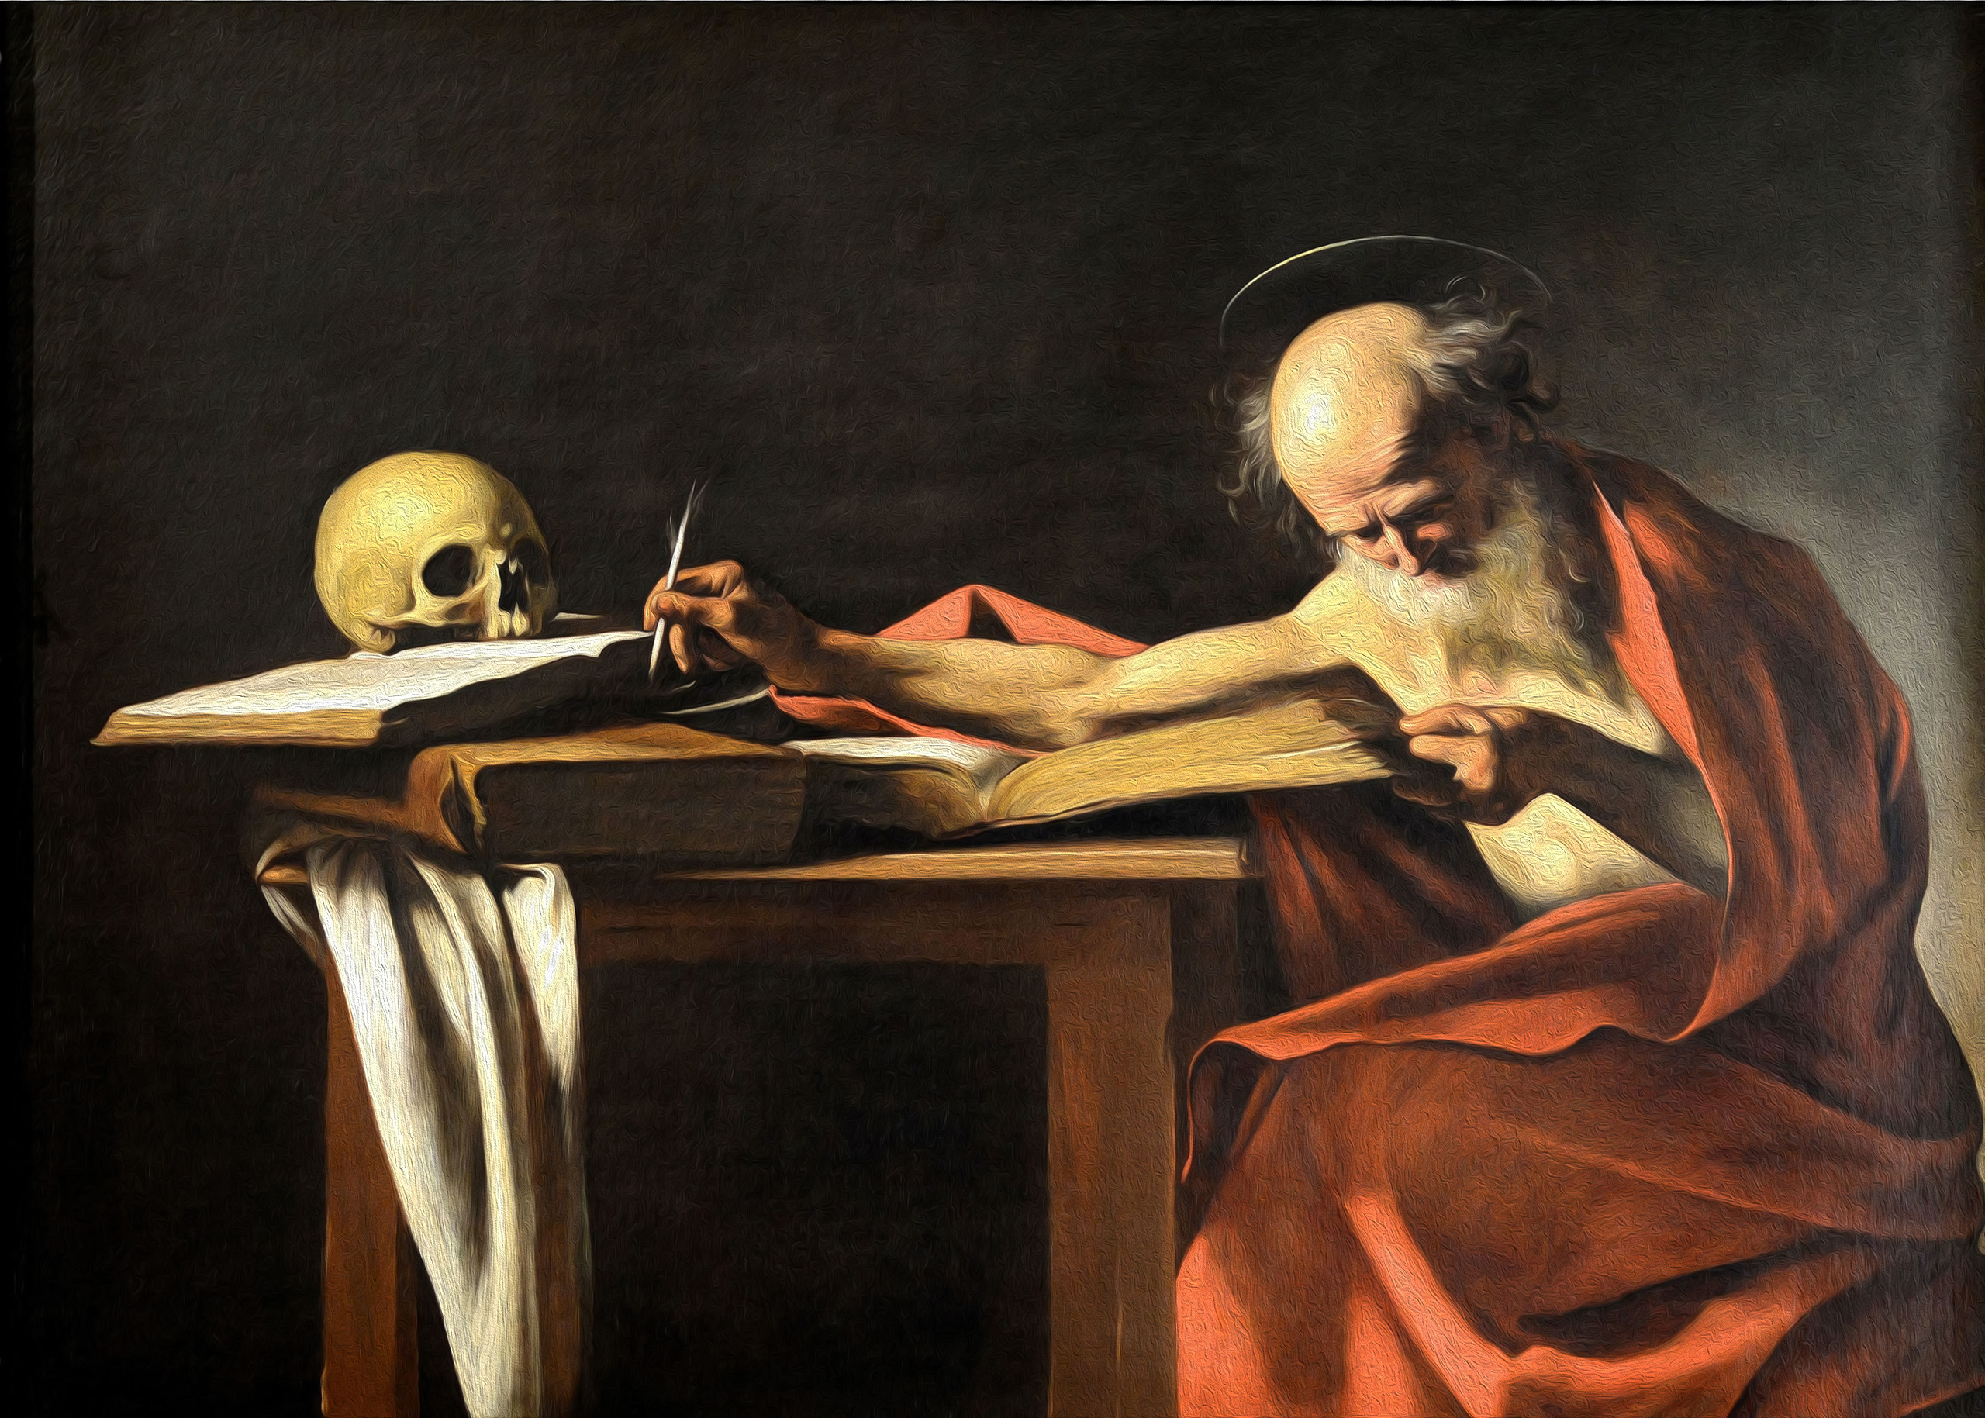
Questions?
If you have any questions regarding the material covered in this lesson, I’d love to hear from you! Email me at ryane_thompson@knights.ucf.edu.
Caravaggio, M. (1606). Saint Jerome. Rome: Galleria Borghese.
Notes:
NOTE: this image was edited in Photoshop to add a modest oil painting effect that subtly enhances the form of shapes and colors.

