Slide 1
American Sign Language
Lindsay Pulse
Next

Slide 2
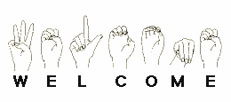
Table of Contents
ASL
ASL pronunciation
How to Learn ASL?
Apps in ASL (slide 6)
Apps in ASL (slide 7)
Fun Facts about ASL
Closing
Back
Next
Notes:
Added the “soft edge rectangle” image effect in picture styles to better enhance the picture border.
Santa Monica College (N.D.). ASL: American Sign Language.
Retrieved from: http://www.smc.edu/AcademicPrograms/ModernLanguage/Pages/ASL.aspx

Slide 3
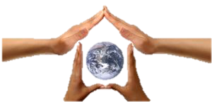
ASL
American Sign Language
More than 500,000 users
Nyle Dimarco
Around
ASL
World
The
TOC
Back
Next
Notes:
In this photo, I removed the white background to make the hands and earth stand out. I also utilized the, “Drop Shadow Rectangle” image effect in picture styles to make the picture look almost 3D.
Star American Sign Language. (2016). Sign Language of the World: ASL is not Universal!.
Retrieved from: https://www.start-american-sign-language.com/languages-of-the- world_html

Slide 4
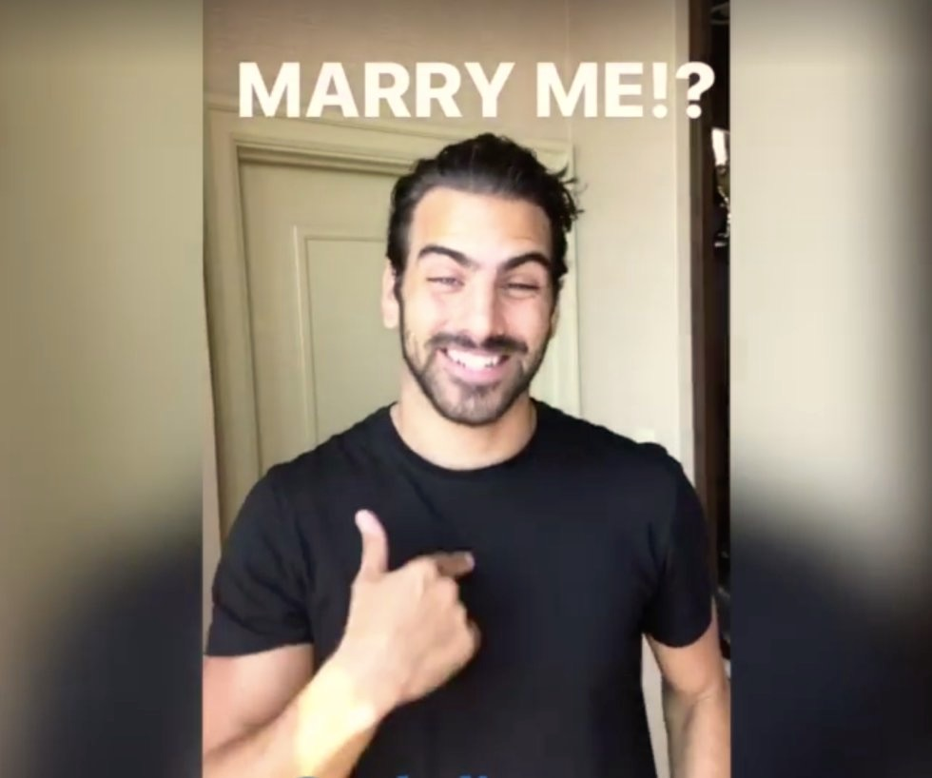
ASL Pronunciation
Own rules
“Do you want to go get pizza?”
Raise voice, widen eyes,
raise shoulders
Nyle raises his eyebrows when he asks, “Marry Me?”
TOC
Back
Next
Notes:
Added the “soft edge rectangle” image effect in picture styles in order to give the picture a better look. I also recolored this image so it looks brighter.
Salandra, Adam. (2016). Nyle Dimarco asks us to marry him in ASL Lesson Video.
Retrieved from: http://www.newnownext.com/nyle-dimarco-asl-lessons-marriage- proposal/09/2016/

Slide 5
How to learn ASL?
UCF ASL Club
Social Media:
@ASLKnights
Websites to Learn ASL
YouTube Videos
Classes offered at UCF for ASL: UCF Catalog
TOC
Back
Next
Notes:
Added the “reflected rounded rectangle” image effect in picture styles to give the picture a better border.
ASLUCFKnights. (2015). ASL Club at UCF presents: Reasons to join.
Retrieved from: https://www.youtube.com/watch?v=kF6Ofcfuqok

Slide 6
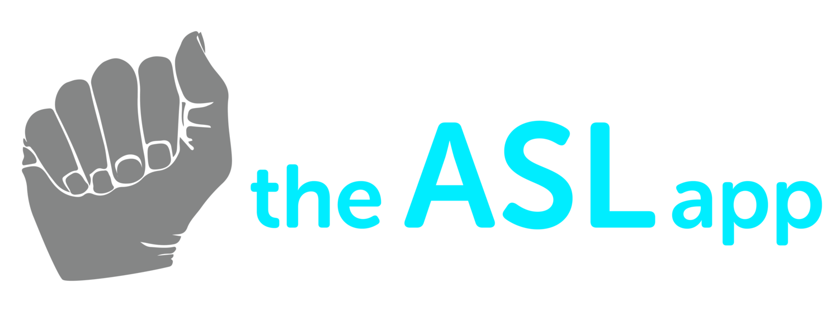
Apps in ASL
Google Apps Free
American Sign Language
Sign Language for Beginners
Google Apps Pay
ASL Translator ($4.99)
ASL Dictionary ($4.99)
TOC
Back
Next
Notes:
I utilized the “Corrections” aspect and mad the image brighter so it would be easier to see.
TheASLApp. (2016). TheASLApp. Retrieved from: http://theaslapp.com/#about

Slide 7
Apps in ASL
iTunes Apple Store Apps Free
The ASL App
ASL American Sign Language
iTunes Apple Store Pay
ASL Dictionary HD American Sign Languages
ASL Expressions
One of many ASL Apps
TOC
Back
Next
Notes:
Added the “drop shadow rectangle” image effect in picture styles. I also recolored the image to black and white.
Software Studios Education. (2014). ASL Dictionary. Retrieved from: https://play.google.com/ store/apps/details?id=com.signtel

Slide 8
Fun Facts about ASL
Sign Language around the world
Third most widely used language
Safer driving records
William Hoy, Cincinnati Reds invented hand signals
Hearing Impaired: lawyers, dentists, doctors, chemists, editors, teachers.
TOC
Back
Next

Slide 9
Closing
Thank you for viewing the presentation
If you have any questions feel free to contact me at:
lpulse@knights.ucf.edu
215-310-8160
TOC
Back
Notes:
I cropped this photo because before, it was a card and I just wanted the “Thank You” part and the hand. I also utilizied the “drop shadow rectangle” option to better enhance this photo.
Macdonald, Helen. (2012). Sign Language Thank You Card. Retrieved from: https:// www.etsy.com/listing/91284371/sign-language-thank-you-card

