Slide 1
Steps to being a great college student
By: Lindsay Pulse

Slide 2
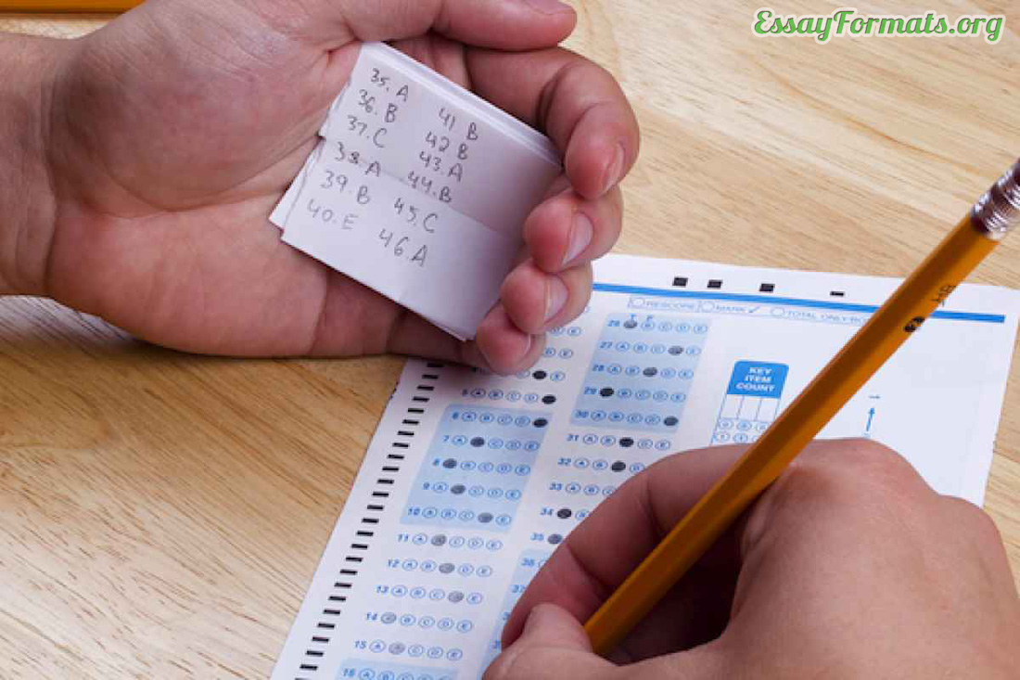
Be responsible
Finish and submit work on time
Participate in group projects
Do not cheat
Bring all material items to class and show up
on time (i.e. pen, notebook, textbook, calculator)

Slide 3
Quiz 1

Slide 4
Be respectful
Always respect your peers
Always respect your professors
Always respect others opinions
Do not talk in class

Slide 5
Quiz 2

Slide 6
go to class
Attend class each day and make accurate notes
Make friends in class for future study sessions
Attend class to gain participation points

Slide 8
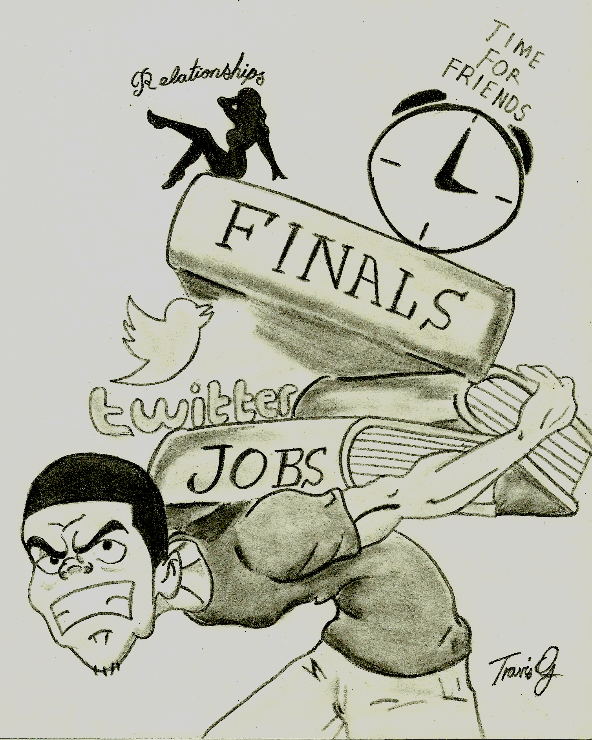
balancing
Balance your social life, family life, and love life and class work/homework
Do not attend your college sporting events if homework or studying needs to be done, attend the next one!
Make sure your manager understands you are in school and need off specific days and times during the semester.

Slide 10
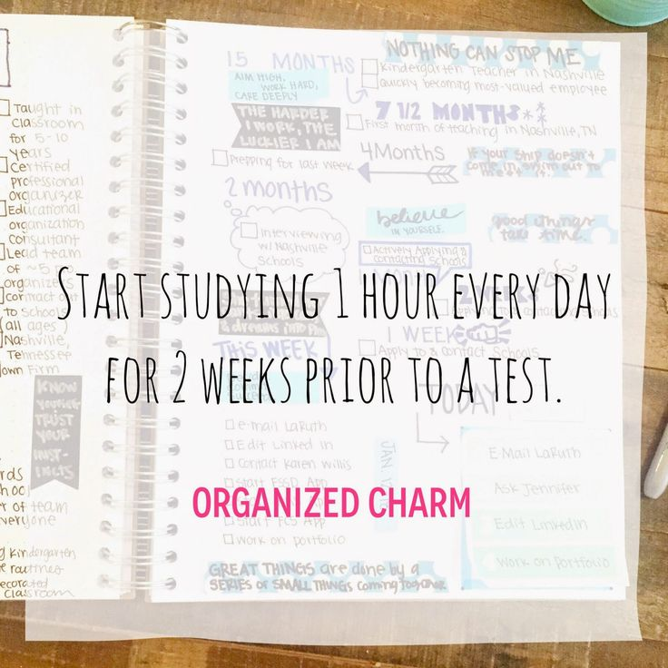
Do not cram or procrastinate
Do not wait until last minute to do your homework, project or study for a test
Ask for help if you are confused and/or need extra credit opportunities
Do not cram all of the information from the semester on the day before your final exam! NOT A GOOD IDEA!

