Slide 1
Florida State EOC Exams

Slide 2
Required testing
Students enrolled in the Florida Public Schools are required to participate in statewide assessments.
FCAT (Reading, Writing, Math, and Science)
FCAT Retakes (retained 10th graders, 11th and 12th graders with non-passing scores)
EOC Assessments (Algebra, Geometry, Biology, US History)
CELLA (ELL students)
PERT/PSAT/PLAN (10th graders- college readiness- GUIDANCE scheduled tests)
**Districts will select testing dates.
Notes:
FCAT and EOC- used for participation/ FCAT, EOC, PERT….counts for school grade (PERT…”other components”)

Slide 3
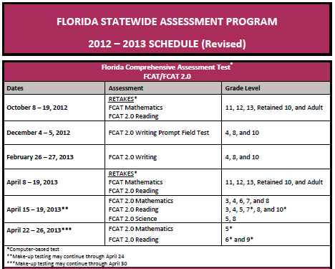
**Districts will select testing dates.
Notes:
Schedule as of Aug. 7th, 2012

Slide 4
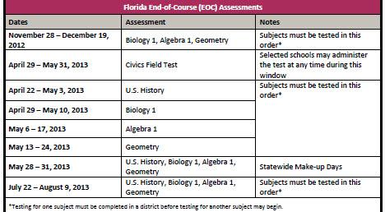
**Districts will select testing dates.
Notes:
Schedule as of Aug. 7th, 2012

Slide 5

Who participates in fcat testing?
Reading
Mathematics
Grades 3-10 (11th and 12th graders retaking FCAT)
Science
3rd graders need a level 2 or higher for promotion
Grades 3-8
EOC Assessments for high school students (exception- 12th graders)
Grades 5 and 8
Writing
Grades 4, 8, and 10
10th graders need a level 3 or higher for graduation
EOC Assessments for high school students (exception- 11th and 12th)

Slide 6
Scoring for Algebra Students
2011 – present
Students will receive a Pass/Fail EOC score. Course credit will be issued once a passing EOC score is achieved.
Students who were 9th graders during the 2010-2011 school year will still have the 30% calculation into their final Algebra grade.

Slide 7

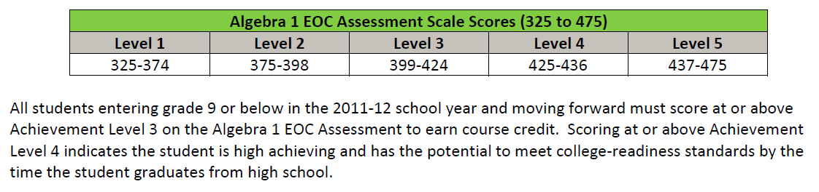

Slide 8
Scoring for Biology and Geometry Students
2012 – 2013
Students will receive a Pass/Fail EOC score. Course credit will be issued once a passing EOC score is achieved.
*Scale scores will be released later this school year.
Students who were 9th graders during the 2011-2012 school year will still have the 30% calculation into their final grade.

Slide 9
Scoring for us history Students
2012 – 2013
Results count as 30% of the course grade regardless of the grade level.
There is not a graduation requirement for students to pass the U.S. History EOC Assessment.

